Slide 1
SQL vs MongoDB

Slide 2
SQL
I-Introduction
For the deployment of Cloud applications, SQL Databases are typically used as Relational Databases. In addition to high-performance analytics, they provide various features for accessing, adding, managing, and processing data. It is a Database System that is easy to use, contains robust classification features, and offers uncomplicated reliability.
II-Features
In general, SQL functions offer many features.
• A SQL operation can easily be implemented using SQL procedural language statements and features, which allow you to integrate control-flow logic into conventional static and dynamic SQL statements.
• A SQL function is usually more reliable than an equivalent external function.
• Provide input parameters.
• Scalar SQL functions return numerical values.
• Provide a powerful but straightforward model for handling conditions and errors.

Slide 3
MongoDB
I-Introduction
It’s an open-source, NoSQL document database. It is popularly used in conjunction with Amazon Web Services, Azure, and other data sources for application development and ongoing operation. In simple terms, MongoDB is a document-oriented database. This open-source product is developed and supported by 10gen.
II-Features
There are the following features of MongoDB:
• There are multiple search options in MongoDB, including field, range, and regular expression categories.
• Any area can index documents.
• A load balancing configuration is automatically implemented because the data is split into shards.
• It provides tools for map reduction and aggregation.
• The code is written in JavaScript instead of Procedures

Slide 4
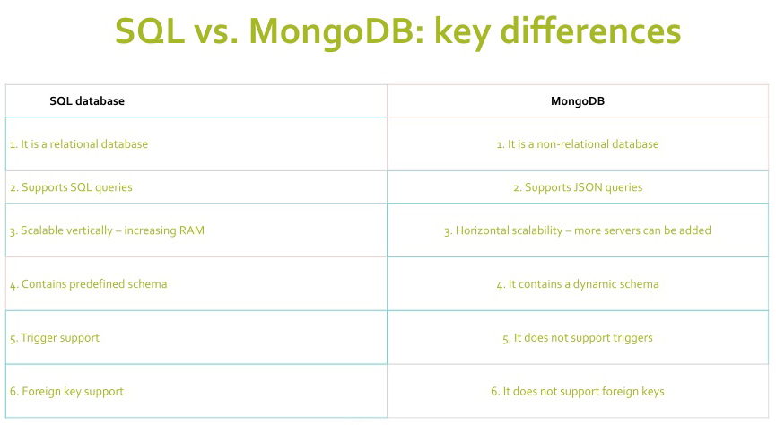

Slide 5
Conclusion
In this presentation, we examined MongoDB and SQL Databases and the various factors that influence both decisions. As a result, it’s fair to say that SQL databases are more appropriate for businesses and industries dealing with structured and relational data. High-traffic websites are benefengine is provided. SQL Databases provide data insertions, custom web functions, quick processing, and fast reliability.

